Slide 1
What is the Purpose of Implementing NER Systems?
Sandy Aoun

Slide 2

NER Task in Broader Context
NER:
Subfield of information extraction
Performed as a first step in an information extraction pipeline
Information Extraction Motivation:
Web and other data is full of unexplored and hidden knowledge
Manual human annotation and/or analysis of such large data is impossible

Slide 3
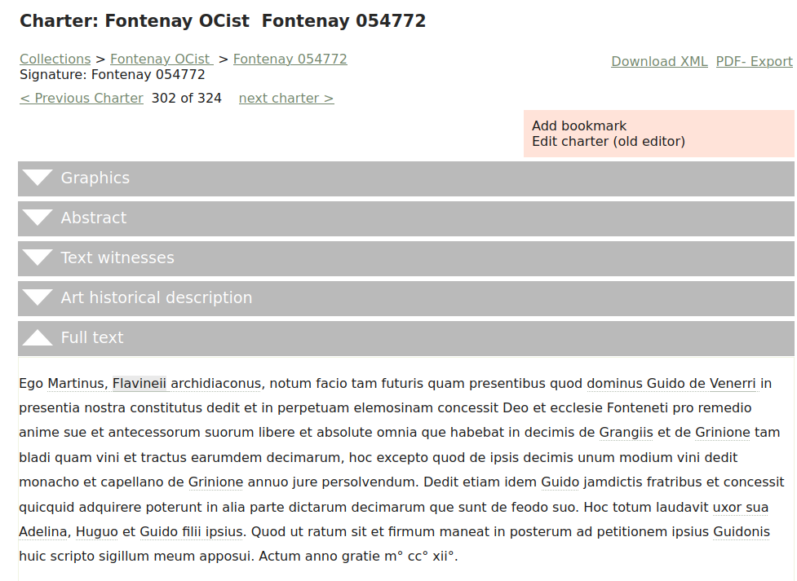
Information Extraction
Subfield of Natural Language Processing
Technical Goal:
Transforming knowledge recorded in un/semi-structured text into a structured machine readable knowledge/data base (automatically)
Primary Purpose:
Speedy automatic exploration, querying, and analysis of an immense quantity of text

Slide 4
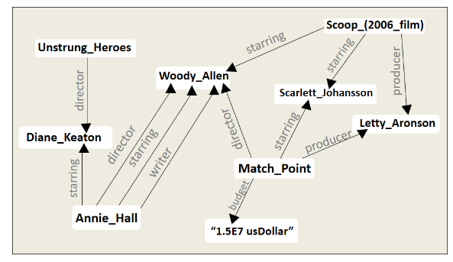
Knowledge Base
Structured collection of data that is organized in a way which facilitates efficient access, retrieval, and management of information

Slide 5
Information Extraction Subfields
Information Extraction Subtasks:
Named Entity Recognition
Relation Extraction
Event Extraction
Coreference Resolution
Named Entity Linking
NER allows for the identification of core basic concepts in texts:
Essential for carrying out other information extraction subtasks

Slide 6
Relation Extraction

Slide 7
Relation Extraction - Definition
Occurrences of entities in a sentence are often linked through well-defined relations:
Occurrence of person and organization in a sentence can be linked through an ‘employed_at’ relation
Relation Extraction Task:
Identifying and extracting relations of interest between NEs automatically
Extracted relations are usually stored in a knowledge base system

Slide 8
Relation Extraction - Example
Sentence: “Elon Musk founded SpaceX, an aerospace manufacturer and space transport services company, in Hawthorne, California, in 2002.”
NER Task:
Elon Musk: Person
SpaceX: Organisation
Hawthorne, California: Location
2002: Time
Relation Extraction Task:
Identify relations between named entities:
located-in(SpaceX, Hawthorne)
founded-by(SpaceX, Elon Musk)
founded-in(SpaceX, 2002)

Slide 9
Event Extraction

Slide 10
Event Extraction - Definition
Original Definition in ACE 2005 [1]:
“An event can be described as a change of state, indicating a specific occurrence of something that happens in a particular time and a specific place involving one or more participants. Event extraction is supposed to provide an answer to the ‘5W1H’ questions, i.e., ‘who’, ‘when’, ‘where’, ‘what’, ‘why’ and ‘how’ about an event.”
Event Extraction Objectives:
Detect event instances in text
Identify the detected event type, as well as all of its participants and attributes
To conduct event extraction, it's crucial to have previously performed NER and RE
Automatic Content Extraction English Annotation Guidelines for Events, Linguistic Data Consortium

Slide 11
Event Extraction - Example
Sentence: “Susan attended a business convention in Warsaw last week.”
Event Extraction Task:
Identify the event “attended a business convention”
Extract details like the participant “Susan”, the location “Warsaw”, and the time “last week”
Entities such as Susan and relations such as located-in(convention, Warsaw) should be known in advance

Slide 12
Coreference Resolution

Slide 13
Coreference Resolution
Coreference Resolution Task:
Determining which different expressions in a text/document refer to the same real-world entity
Example:
“The president George W. Bush nominated Colin Powell as his secretary of state on Monday. He is also set to attend the G7 meeting in Germany later in the week.”
System would identify that ‘The president’, ‘his’, and ‘He’ refer to ‘George W. Bush’

Slide 14
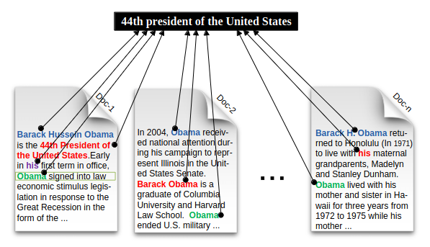
Cross-Document Coreference Resolution
Identifying mentions of the same entity across multiple documents
Beheshti et al. 2013

Slide 15
Named Entity Linking

Slide 16
Named Entity Linking - Definition
Entity Linking Task:
Aligning textual mentions of entities to their corresponding entries in a knowledge base (KB)
Entity Linking Objective:
Match entities to existing entities in the KB to avoid duplication
Add any additional information about matched entities to the KB
Create new entry in the KB if entity inexistant/not matched

Slide 17
Named Entity Linking - Example
Sentence: Knowledge Base Entry:
‘During his short stay in Paris,
he arranged a visit to the Entity: Eiffel Tower
Eiffel Tower’s summit.’ Attributes:
Unique Identifier: tower_3529
Height: 330 meters
Primary Function: Observation tower
Construction Starting Date: January 28, 1887
Construction Completion Date: March 31, 1889
Relationships:
Located In: Paris
Architect: Gustave Eiffel
Additional Information:
Visitor Information: Annual visitors approximately 7 million
Design Features: Constructed from wrought iron, consisting of three levels

Slide 18
Named Entity Linking - Complex Example
Sentence: “Mr. Bush left for the Zurich environment summit in Air Force One.”
Does Bush refer to the knowledge base entry:
41st U.S. president George H. W. Bush
43rd U.S. president George W. Bush
Context around the sentence should match a distinctive information associated with one of the entries

Slide 19
References
Ace (Automatic Content Extraction) English Annotation Guidelines for Events, Linguistic Data Consortium, Philadelphia, PA, USA, 2005
Beheshti, S.M.R., Venugopal, S., Ryu, S.H., Benatallah, B. and Wang, W., 2013. Big data and cross-document coreference resolution: Current state and future opportunities. arXiv preprint arXiv:1311.3987.

